Slide 1

Project Overview
Represent the impact global temperature has on arctic sea ice and global sea levels from 1980-2019
Telling the story of climate change through visualizations

Slide 2
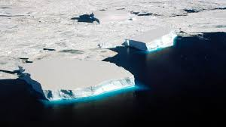

Coding overview
Chosen approach/Why selected?
Adjustments made to page layout/design
Inclusion of Highcharts/coding for dropdown menu
Discuss issues/changes made

Slide 3
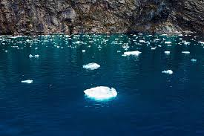
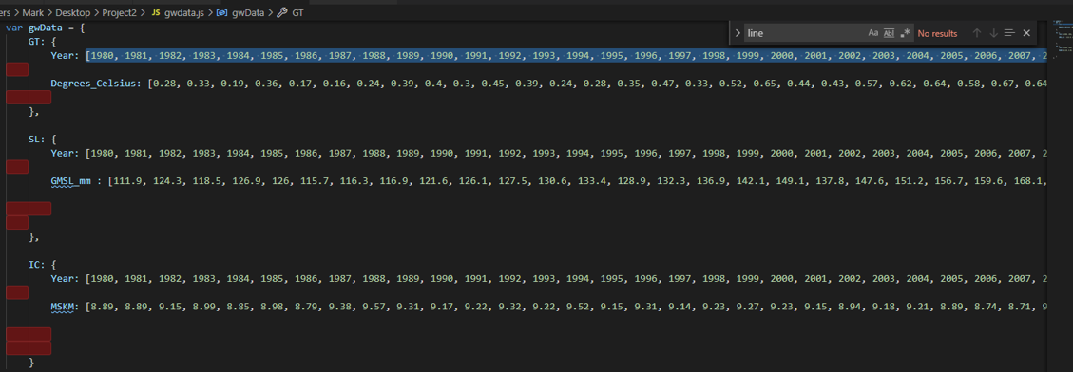
Data
Why we selected certain data types
Sources for pulling data
Cleaning/Presentation

Slide 4
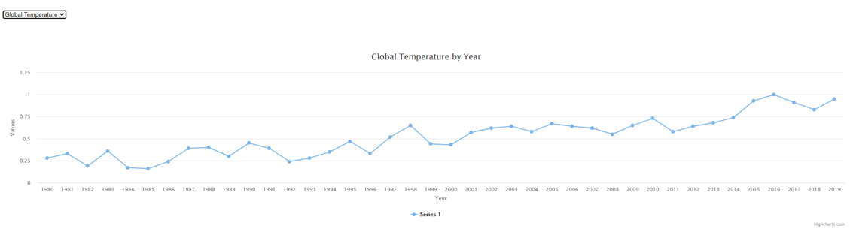
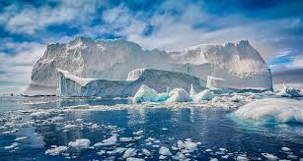
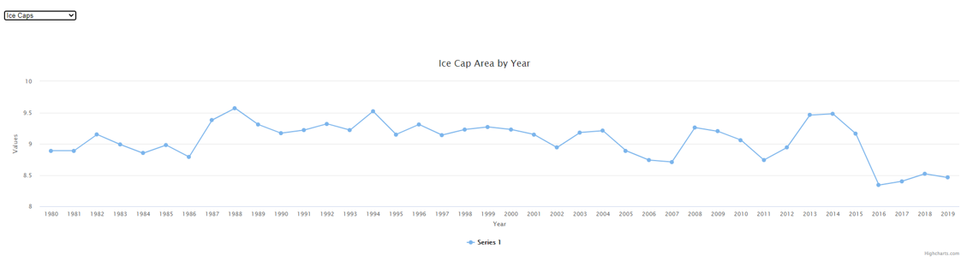
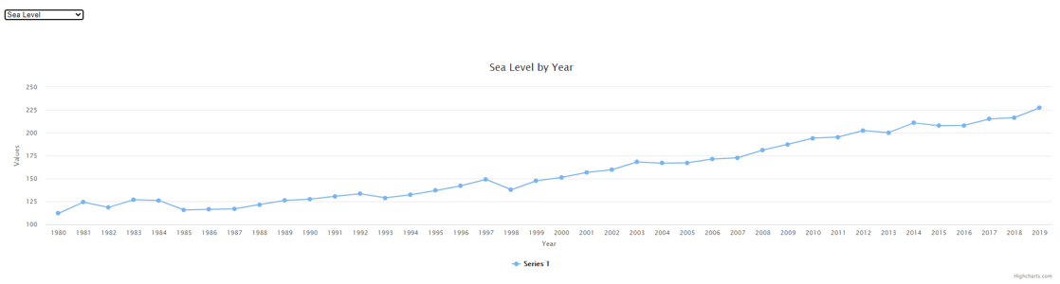

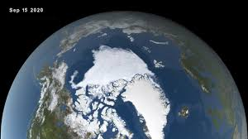
Visualizations

